Slide 1
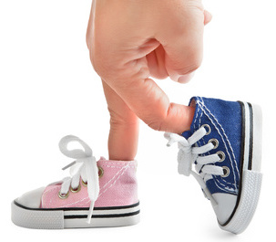
START WITH THE RIGHT FOOT
And Experience Total Transformation
Lidia Belkis Archbold
Health Ministries
Inter-American Division

Slide 2
Before creation, God already had a plan for us.
Sin came into the garden and interrupted the plan; however, God with His immeasurable love, had a “plan B” in store.
This is the marvelous Plan of Redemption. Where He died on the cross of Calvary so we could have eternal salvation.
(1 Pedro 2:24)

Slide 3
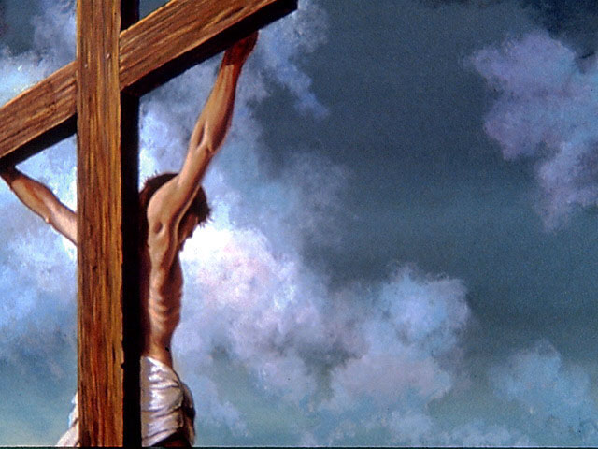
1 Peter 2: 24 (NKJV)
²⁴ who Himself bore our sins in His own body on the tree, that we, having died to sins, might live for righteousness by whose stripes you were healed.

Slide 4
Why start with the right foot?
At the beginning of the year, we all make resolutions that are forgotten a few weeks down the road.
We usually want to:
1. Do more exercise
2. Eat healthy
3. Be positive
4. Lose weight
5. Do more Bible study
6. Save for a project, etc. etc.

Slide 5
This year we must do it differently. Let us start with our right foot; not thinking about what to stop doing or what to start doing, rather what is it that we need to modify.

Slide 6
b) Let us begin the year by placing our priorities in the correct order.
Usually we affirm that we are integral beings created with specific dimensions.
Physical, Mental and Spiritual

Slide 7
What if we start with…
A spiritual, mental-emotional and physical transformation, (not necessarily in that order) without preferences to one or another, since we were created with those specific dimensions for our total well-being.

Slide 8
E.G. White counsels us as follows:
Let us place ourselves in right relation to Him who has loved us with amazing love. Let us avail ourselves of the means provided for us that we may be transformed into His likeness, and be restored to fellowship with the ministering angels, to harmony and communion with the Father and the Son. Steps to Christ 22.

Slide 9
Only through a close and constant relationship with God we will gain a transformation in our lives.
Let me share with you a quote from Mrs. E. G. White.

Slide 10
Even John, the beloved disciple, the one who most fully reflected the likeness of the Savior, did not naturally possess that loveliness of character. He was not only self-assertive and ambitious for honor, but impetuous, and resentful under injuries. But as the character of the Divine One was manifested to him, he saw his own deficiency and was humbled by the knowledge. The strength and patience, the power and tenderness, the majesty and meekness, that he be held in the daily life of the Son of God, filled his soul with admiration and love.

Slide 11
Day by day his heart was drawn out toward Christ, until he lost sight of self in love for his Master. His resentful, ambitious temper was yielded to the molding power of Christ. The regenerating influence of the Holy Spirit renewed his heart. The power of the love of Christ wrought a transformation of character. This is the sure result of union with Jesus.

Slide 12
When Christ abides in the heart, the whole nature is transformed. Christ’s Spirit, His love, softens the heart, subdues the soul, and raises the thoughts and desires toward God and heaven. Steps to Christ 73.1
This should be our thought as we walk with God day by day.

Slide 13
Once we have established that close relationship with the Creator where we experience and reflect His transforming grace, we will be ready to take on a positive attitude that will help us to maintain a healthy mind.

Slide 14
Mental health is a topic that we have avoided or sidelined for a long time.
WHO (World Health Organization) said:
“THERE IS NO HEALTH WITHOUT
MENTAL HEALTH”
Notes:
Quiere decir, no importa cuanto énfasis ponemos en la salud física, si esta no esta acompañada de salud mental, nuestro bienestar no será total, pues una tiene influencia en la otra.

Slide 15
E. G. White
The mind controls the whole man. All our actions, good or bad, have their source in the mind. It is the mind that worships God and allies us to heavenly beings.... All the physical organs are the servants of the mind, and the nerves are the messengers that transmit its orders to every part of the body, guiding the motions of the living machinery.... 2MCP 396.1

Slide 16
E.G. White
But few realize the power that the mind has over the body. A great deal of the sickness which afflicts humanity has its origin in the mind and can only be cured by restoring the mind to health. 2MCP 396.4
Notes:
La OMS, esta en lo cierto cuando dice, que sin salud mental no hay salud, pues entre la mente y el cuerpo hay una relación muy intima.

Slide 17
As we start this year on the right foot…
Let us cultivate a positive mind set.
Let us shun negative thoughts.
Let us promote a spirit of thanksgiving.
Let us practice pardon.
Let us forget ill feelings.
Let us learn to laugh more.
Let us share what we have with the needy.
Notes:
Nuestra actitud en la vida juega un papel muy importante en nuestra salud mental. Si nos acostumbramos a albergar pensamientos negativos, estamos dando a Satanás la oportunidad de invadir nuestra mente, la cual debe estar en completa armonía con Nuestro Creador,

Slide 18
E. G. White
Nothing tends more to promote health of body and of soul than does a spirit of gratitude and praise. It is a positive duty to resist melancholy, discontented thoughts and feelings—as much a duty as it is to pray. If we are heaven-bound, how can we go as a band of mourners, groaning and complaining all along the way to our Father’s house? MH 251.3

Slide 19
Starting on the right foot is also to:
Take care of our physical body which is the temple of the Holy Spirit.
1 Corinthians 6:19
¹⁹ Or do you not know that your body is the temple of the Holy Spirit who is in you, whom you have from God, and you are not your own?
Notes:
Si nuestro cuerpo es morada de ES, es nuestro deber y responsabilidad cuidarlo.

Slide 20
Three basic factors that should not be absent al we care for our bodies.
1. Water – Hydrate it
2. Exercise – Move it
3. Rest – Give it rest

Slide 21
1. Water
Drinking water is very important for the whole body. It is between 60-70% water, which indicates that our organs needs water to function well.
Water has many functions. It helps in the absorption of the food we eat.
It helps in the transportation of nutrients and oxygen to the cells.
It also helps in the elimination of toxins and waste.
Notes:
Hay un sin numero de funciones del agua en nuestro organismo. El hombre puede vivir muchos días sin alimento, pero no puede vivir mas de 5 días sin tomar agua

Slide 22
2. Exercise
If you want to look good and feel good, move your body.
Exercise can predict longevity. That is how long you can live.
Exercise increase the flow of blood to the brain and helps us to think and concentrate better.
It increases the electrical activity of the nerve cells (neurons) of the brain.
It strengthens muscles, bones and connective tissues.
According to the WHO, many of the Chronic non Communicable Diseases are associated with the lack of exercise.

Slide 23
E. G. White
Inactivity is a fruitful cause of disease. Exercise quickens and equalizes the circulation of the blood, but in idleness the blood does not circulate freely, and the changes in it, so necessary to life and health, do not take place. MH 238.1

Slide 24
Adequate Rest
Rest is the halting of all physical and mental activity voluntarily. It is indispensable for the health of the human body.
Resting and sleeping are two different activities. However the most effective mechanism that the human body uses to rest is sleep.
Lack of sleep affects the immune system, it weakens the natural defenses and permits pathogens to enter the body thus increasing the incidence of colds.
Lack of rest diminishes motor and neurological skills that affects coordination and learning.

Slide 25
E. G. White
Give the weary brain a rest. Unseasonable hours are destructive to the physical, the mental, and the moral powers. If the brain were given proper periods of rest, the thoughts would be clear and sharp, and business would be expedited. 3TT 196.2

Slide 26
Following these simple steps in our lives we can focus on integral health.
Starting on the right foot will permit us to:
Develop and intimate relationship with God
Experience a Spiritual Transformation.
Enjoy a more robust mental health.
Admirable Physical health.

Slide 27
Remember that changes must be made with purpose; not only because we follow the customs of new year resolutions.
Changes must be made little by little for them to be effective and permanent.
Only the power of Christ will give us strength. Let us hold fast to the promise.
Philippians 4:13
“I can do all this through Him who gives me strength ”

Slide 28
Conclusion:
Nothing else in this world is so dear to God as His church. He will work with mighty power through humble, faithful men. Christ is saying to you today: “I am with you, co-operating with your faithful, trusting efforts, and giving you precious victories.” 7T 242.3

