Slide 1


The function of Policy in Board and Committee meeting
Dr. Elie Henry

Slide 2


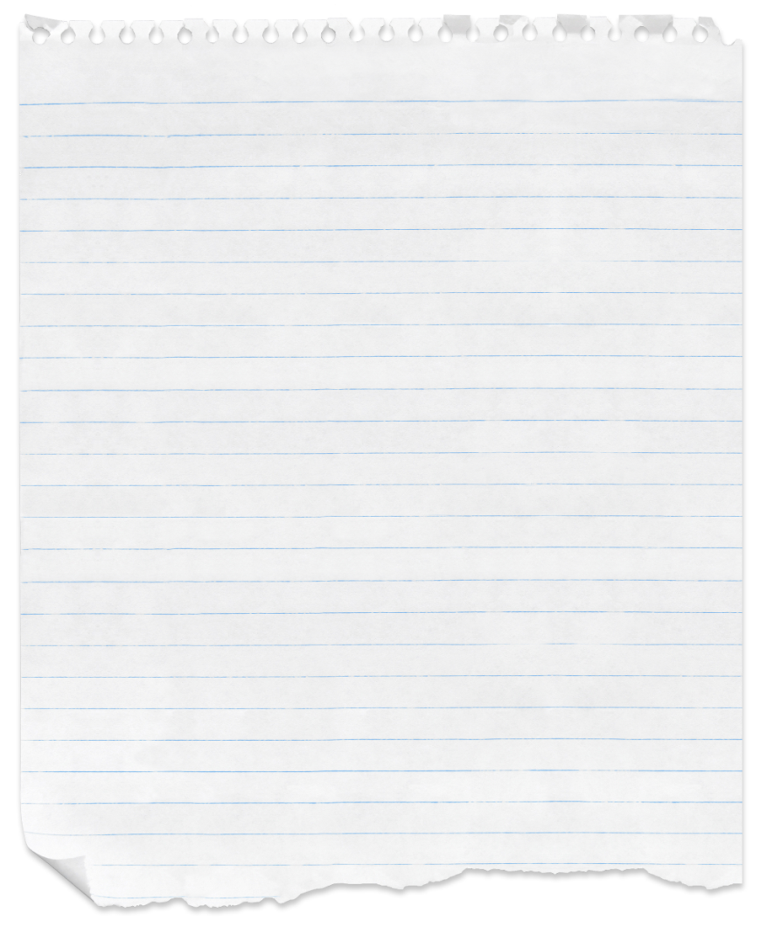
Policy - Definition
“a plan of action”
“a way of management”

Slide 3
Why Policy?
Policies serve as the foundation for holding an administrator accountable. Accountability in today’s litigation obsessed society is a must.
In our efforts to provide guidance to our administrators we must be careful to not take away from their ability to apply good judgment and discretion as they accomplish their duties.

Slide 4
Why Policy?
Well thought out and written policies provide administrators with the guidance they need to be more professional in the execution of their responsibilities.

Slide 5
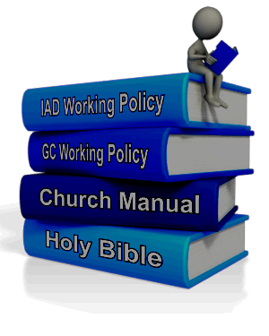
Policy’s purpose
To protect the organization from:
Autocratic and erratic leadership
Merely reactive decision-making
Widely differing patterns of action

Slide 6
Policy’s function:
Defines how we do our work
Represents a collective decision-making process (executive committee).
General Conference Working Policy is the policy framework for the world Church.
The Church Manual is the policy framework for the operations of local churches.
Is dynamic, can be amended.

Slide 7
Policy: the big picture
Organizational Structure
Operating Principles
Procedures and Practices

Slide 8
Which come first?

Slide 9

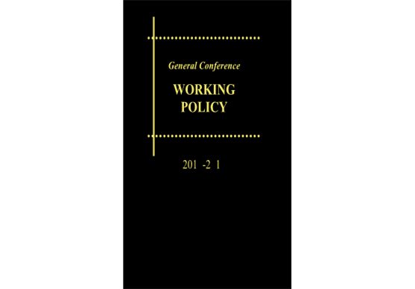
GC Working Policy
B 04 05 Authoritative Voice of the Church.-
The General Conference Working Policy contains the Constitution and Bylaws of the General Conference and the accumulated policies adopted by General Conference sessions and Annual Councils of the General Conference Committee. It is, therefore, the authoritative voice of the Church in all matters pertaining to the administration of the work of the Seventh-day Adventist denomination in all parts of the world.

Slide 10
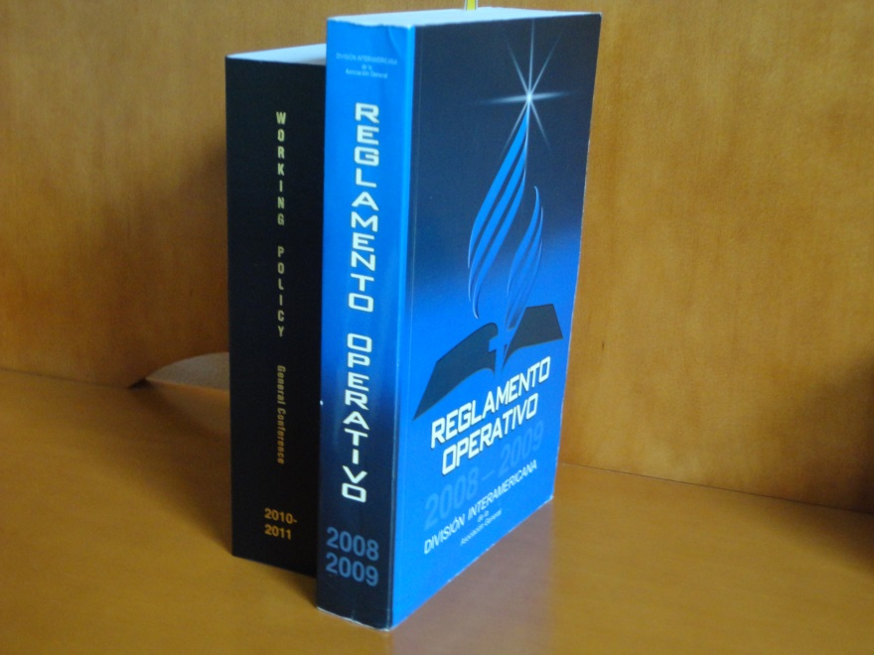
IAD Working Policy
Divisions are authorized by the General Conference to make policies not already covered in the General Conference Working Policy to govern the work in the division territory. Such policies must not be in conflict with the General Conference Policy.

Slide 11
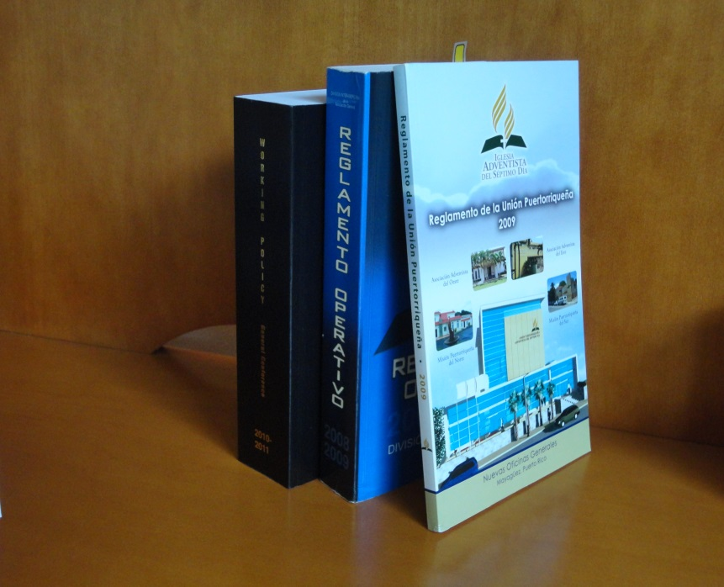
Union Working Policy
Union committees may make policies to address specific concerns in the union territory that have not been covered by the General Conference or Division policies. Unions may not make policies that conflict with the General Conference or Division.

Slide 12
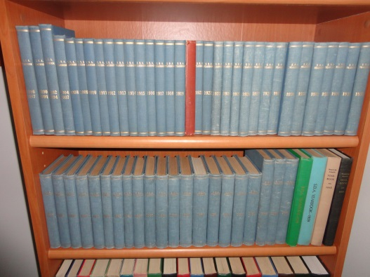
Constitution and Bylaws
Conference
Mission
Institutions

Slide 13
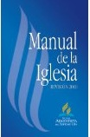
Two policy books—different roles
Operation of the organizations
Operation of local church
²⁰¹²⁻²⁰¹³

Slide 14
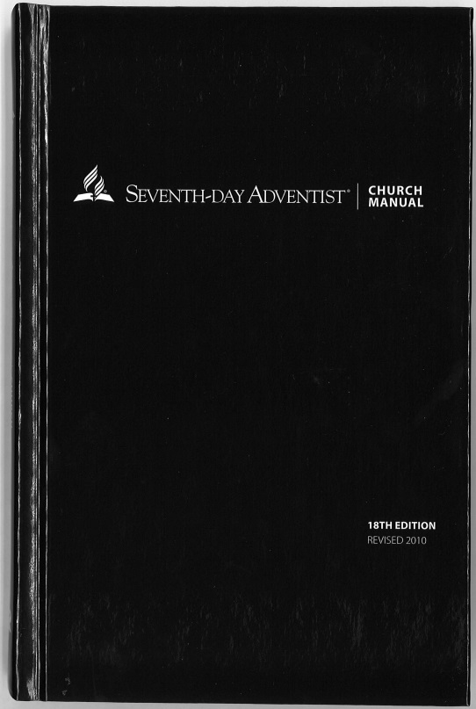
Church Manual
B 60 05 Standards and Practices
The standards and practices of the church are based upon the principles set forth in the Church Manual published by the General Conference. These principles are to be followed in all matters pertaining to the administration of local churches both within the church and in its relationship to the higher organization, the mission or conference.

Slide 15
Church Manual
B 60 05 Standards and Practices
… No attempt should be made by any employee to set up standards of membership or to make, or attempt to enforce, rules or regulations for the church which have not been adopted by the general body of believers and which are not set forth in the Church Manual.

Slide 16
Which come first?

Slide 17
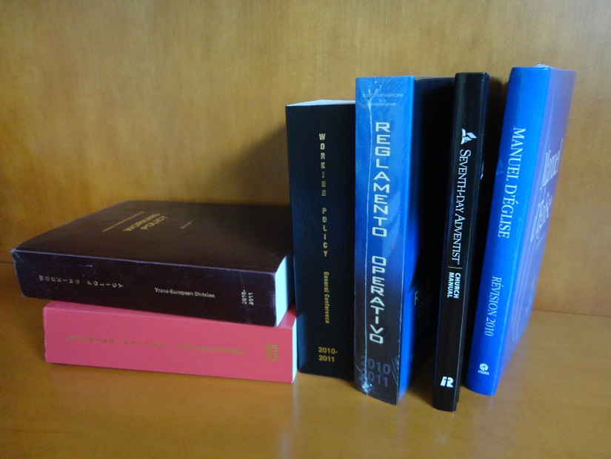
All to adhere to WP
B 04 10 Adherence to Policy Required
To maintain close cooperation and unity
The General Conference Working Policy shall be strictly adhered to by all organizations in every part of the world field. The work in every organization in the Division territory shall be administered in full harmony with the policies of the General Conference and of the Inter-American Division. No departure from these policies shall be made without prior approval from the General Conference and/or the Division Committee.

Slide 18
Officers and administrators to work in harmony with Working Policy
B 04 15
Those who show inability or unwillingness to administer their work in harmony with policy should not be continued in executive leadership by their respective constituencies or governing boards/committees

Slide 19
Policies and Local Law
In the event laws/changes in the laws governing a country seem to render compliance with denominational policies a violation of the law, the organization shall act in harmony with the law, provided the following:
  a. Counsel has been sought from the IAD, and it is established that denominational policies do indeed violate the law.
  b. Compliance with the law does not constitute a violation of scriptural principles.

Slide 20
Maintaining Integrity
Treats everyone with fairness and equality without favoritism or discrimination.
All person are treated fairly with dignity and respect. The environment is free from discrimination, hostility or any form of harassment.
Commitments and contracts are honored even if it is unfavorable to the person making the commitment

Slide 21

Familiar with the WP

Slide 22


Slide 23
Areas covered by IAD-WP
General administrative matters
Working
Policy
Employee/employer relationship
Department Policies
Financial Policies
Retirement Matters
“ ”

Slide 24
No committee member can afford to ignore or violate:
Conflict of Interest
Sexual Harassment
Hiring and Firing

Slide 25
No administrator can afford to ignore or violate:
Retention and safeguarding of records
Use of the tithe
Financial responsibilities
Benefit Plan for Employees

Slide 26

.

Slide 27

-
..

